Slide 1


Trial Connect
Guiding potential patients through the Trial Sign-up process, step-by-step
Speakers: Rachael Camp, Shruti Pistolwala Extended Team: Anran Cai, Lucie Huang, Letícia Gonçalves, Arati Shinde
Notes:
The world has seen the time taken by COVID vaccines to come out when they were needed the most, but even with the awareness of the trial process under the watch of the world of the entire world, Pfizer-BioNTech and Moderna vaccines, were not tested with a patients who reflected the ethnic diversity of the US population. This highlights an industry wide problem, hence we came up with a way to make recruitment easier.

Slide 2

Our Problem
Current recruitment methods for clinical trials face difficulties in recruiting a diverse population. Patients are either referred by a Healthcare Professional, or face a difficult, frustrating and time consuming search process* to find a trial that they are eligible for.
Notes:
We focussed on the difficulties in recruiting participants to join clinical trials and we see often it is the job of physicians to refer patients, although this landscape is changing. (CISCRP noted around a 6% drop in doctor/specialist referrals between 2019 and 2021). We chose to focus on self registration because a lesser focus on doctor referral has the potential to speed up the process and allow for a larger, more diverse pool of patients.

Slide 3
Most Frequently Experienced Clinical Trial Pain Point
44%*
Cited Patient Enrollment
Nearly half of clinicians surveyed in Swiss University Hospitals cited Patient Enrollment as their biggest difficulty relating to running clinical trials
1
Notes:
In order to understand the impact of recruitment, we look at pain points experienced by those running the trials.

Slide 4
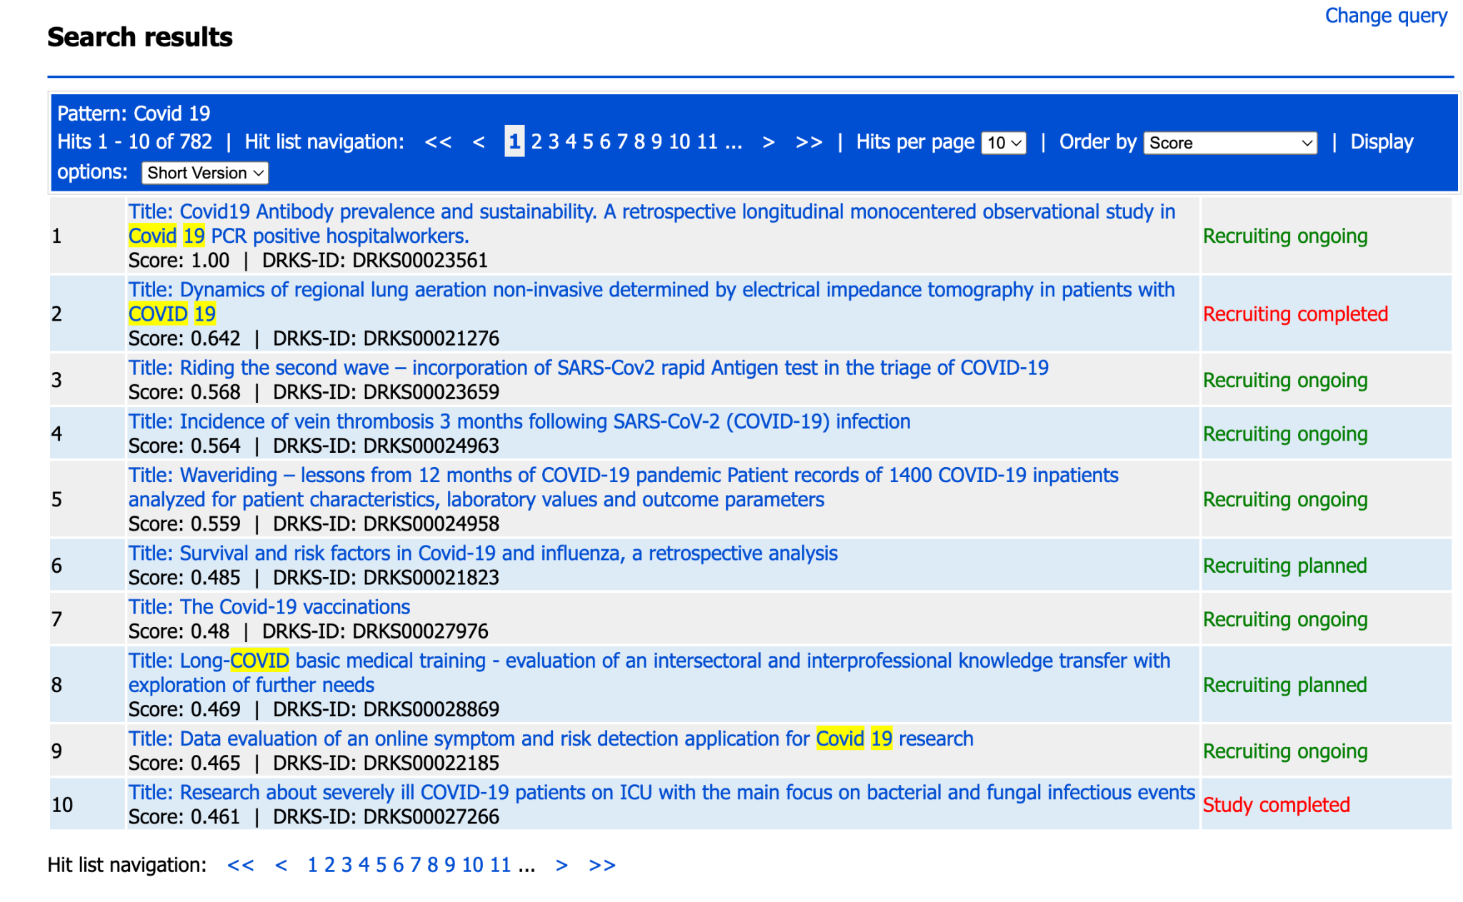
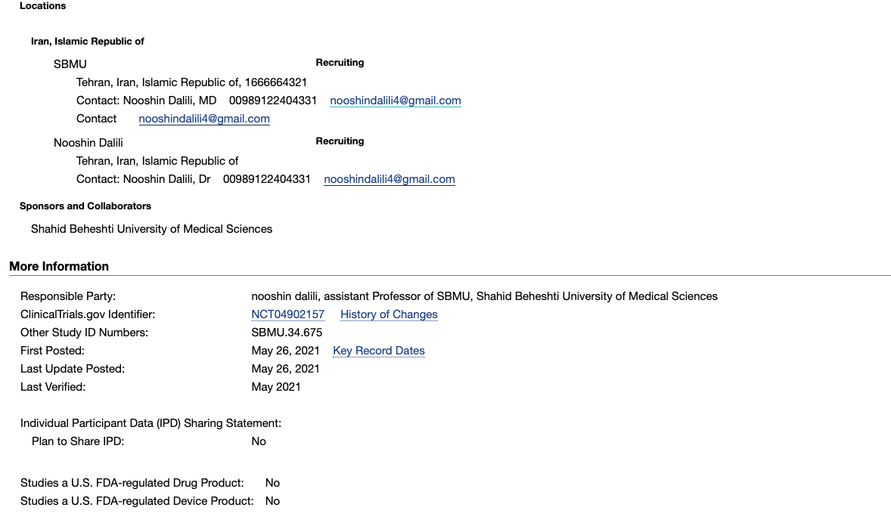
Usability Issues
Initial investigation of clinical trial search sites revealed major usability issues and lack of patient focus on a number of sites:
Confusing layout and menus
Lack of focus state
Long, confusing, improperly labelled, inaccessible forms
Large amount of medical language
Lack of clear navigation
Notes:
We couldn’t do a full benchmarking study, given that this usually takes one to two weeks to complete, but these are our initial, high level observations. There is a particular issue for aging, disabled and non-native language users, but improving usability and accessibility would make things better for everyone, using these types of services

Slide 5
Our Approach
Inform
Guide
Refer
Our platform will be a place where patients can ask questions and get personalised feedback about their trial eligibility
Our Chatbot will act as an advisory and also does the hard work for the patient, screening them and giving intelligent recommendations based on their feedback
Once the patient data is collected, the chatbot will screen criteria against what is needed for criteria in terms of age, ethnicity, pre existing conditions, and other stated parameters
Notes:
Our approach has three key elements: Patients can get answers to their questions and concerns, they can guided through a trial search and screening process and once this is complete their details are instantly shared with the trial organiser.

Slide 6

User Story
Our user: Ceyda, 55 from Germany engages with our Chatbot, to ask questions about clinical trials in her native Turkish, search for clinical trials in her area and go through the registration process, with the bot walking her through every step.
EXPLORE CEYDA’S JOURNEY
Notes:
We created a customer journey story, describing how a user would go through the inform, guide and refer process.

Slide 7
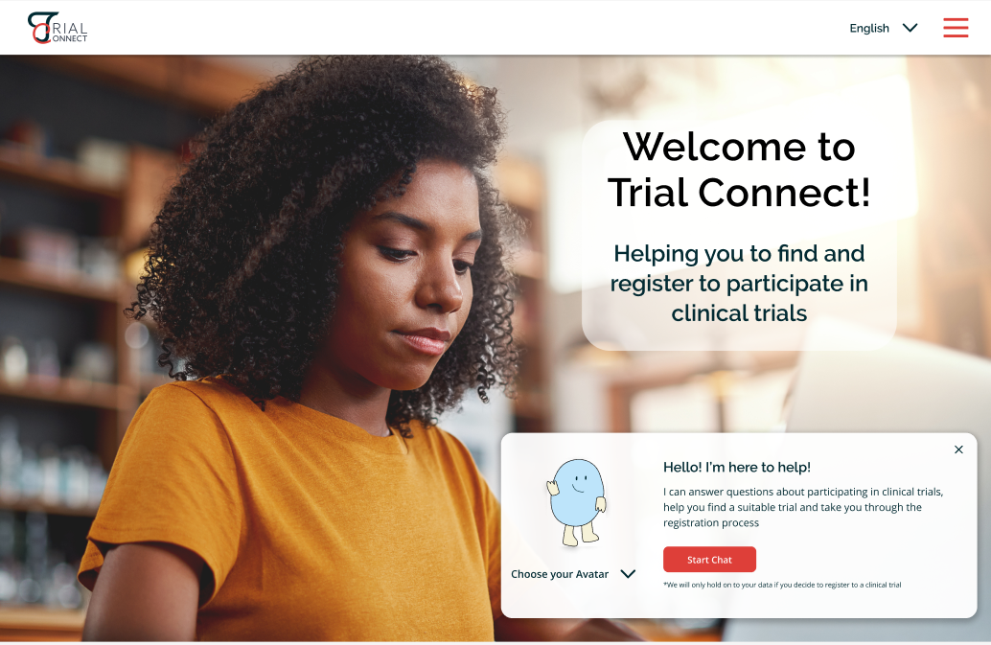
User Experience
Ceyda visits Trial Connect, engages with the Chatbot and finds a suitable trial in her area that she would like to register for.
PREVIEW HER EXPERIENCE
Notes:
Then we created a visual, non functioning prototype which would represent her journey.

Slide 8
Our Features
Natural Language Processing
Language Selection
Audio Instruction
Open Source Data
Data Privacy and Security
GPT-3
Notes:
The chatbot application would consist of various features such as language selection, audio based instruction, data privacy and security as well as various NLP models such as GPT-3 and many other open source data models.

Slide 9


Now we will show you how our Chatbot could work
Notes:
We will walk you through our demo now

Slide 10
Timeline
Pilot Launch for Product
Phase 1
Widen Customer Base ( Research Institutes)
We promote our platform via a variety of sources (e.g., universities, influencers, WHO, online pharmacies, health insurance companies, doctor appointment platforms)
Phase 2
We sell our chatbot service to clinical trial organizers and current existing clinical trial search and register platforms, to help them with better navigation in their own websites
Phase 3
Notes:
Our rollout will be in three phases. In phase one we do a pilot launch where we will get feedback on our prototype and improve based on that. Then we will approach research institutes, health/disease specific influencers and communities, pharmaceutical companies and other potential opportunities. In the third phase the chatbot can be sold as a standalone product to clinical trial organizers to integrate into their system.

Slide 11



Existing Solution
Panel
End to End Recruitment
Full Study
Inform
Find
Screen
Register
Meet diverse quotas
Self-Referral
Notes:
Like any business, we have competitors who are working on same issue with a different approach, however no one is currently providing a complete end to end solution from finding candidates to guiding them through screening, helping them register and giving references as to whether they can do the trial. All of this will help in getting diverse background candidates.

Slide 12
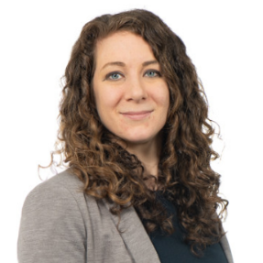



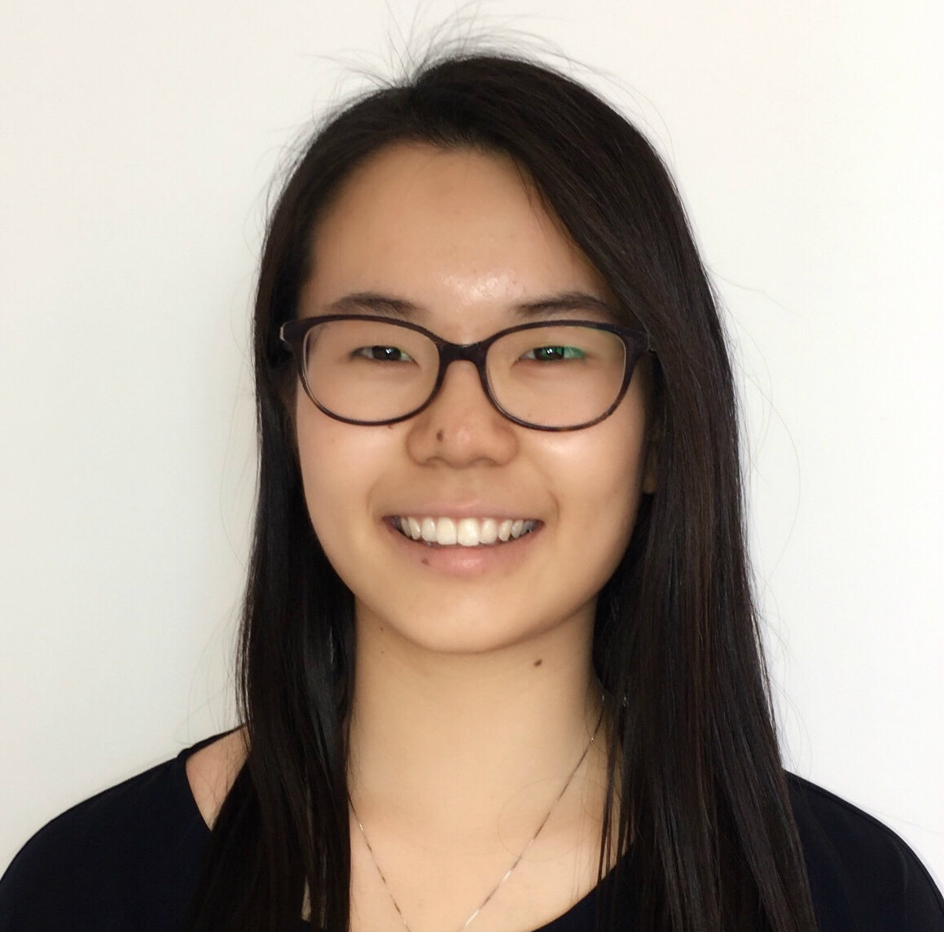

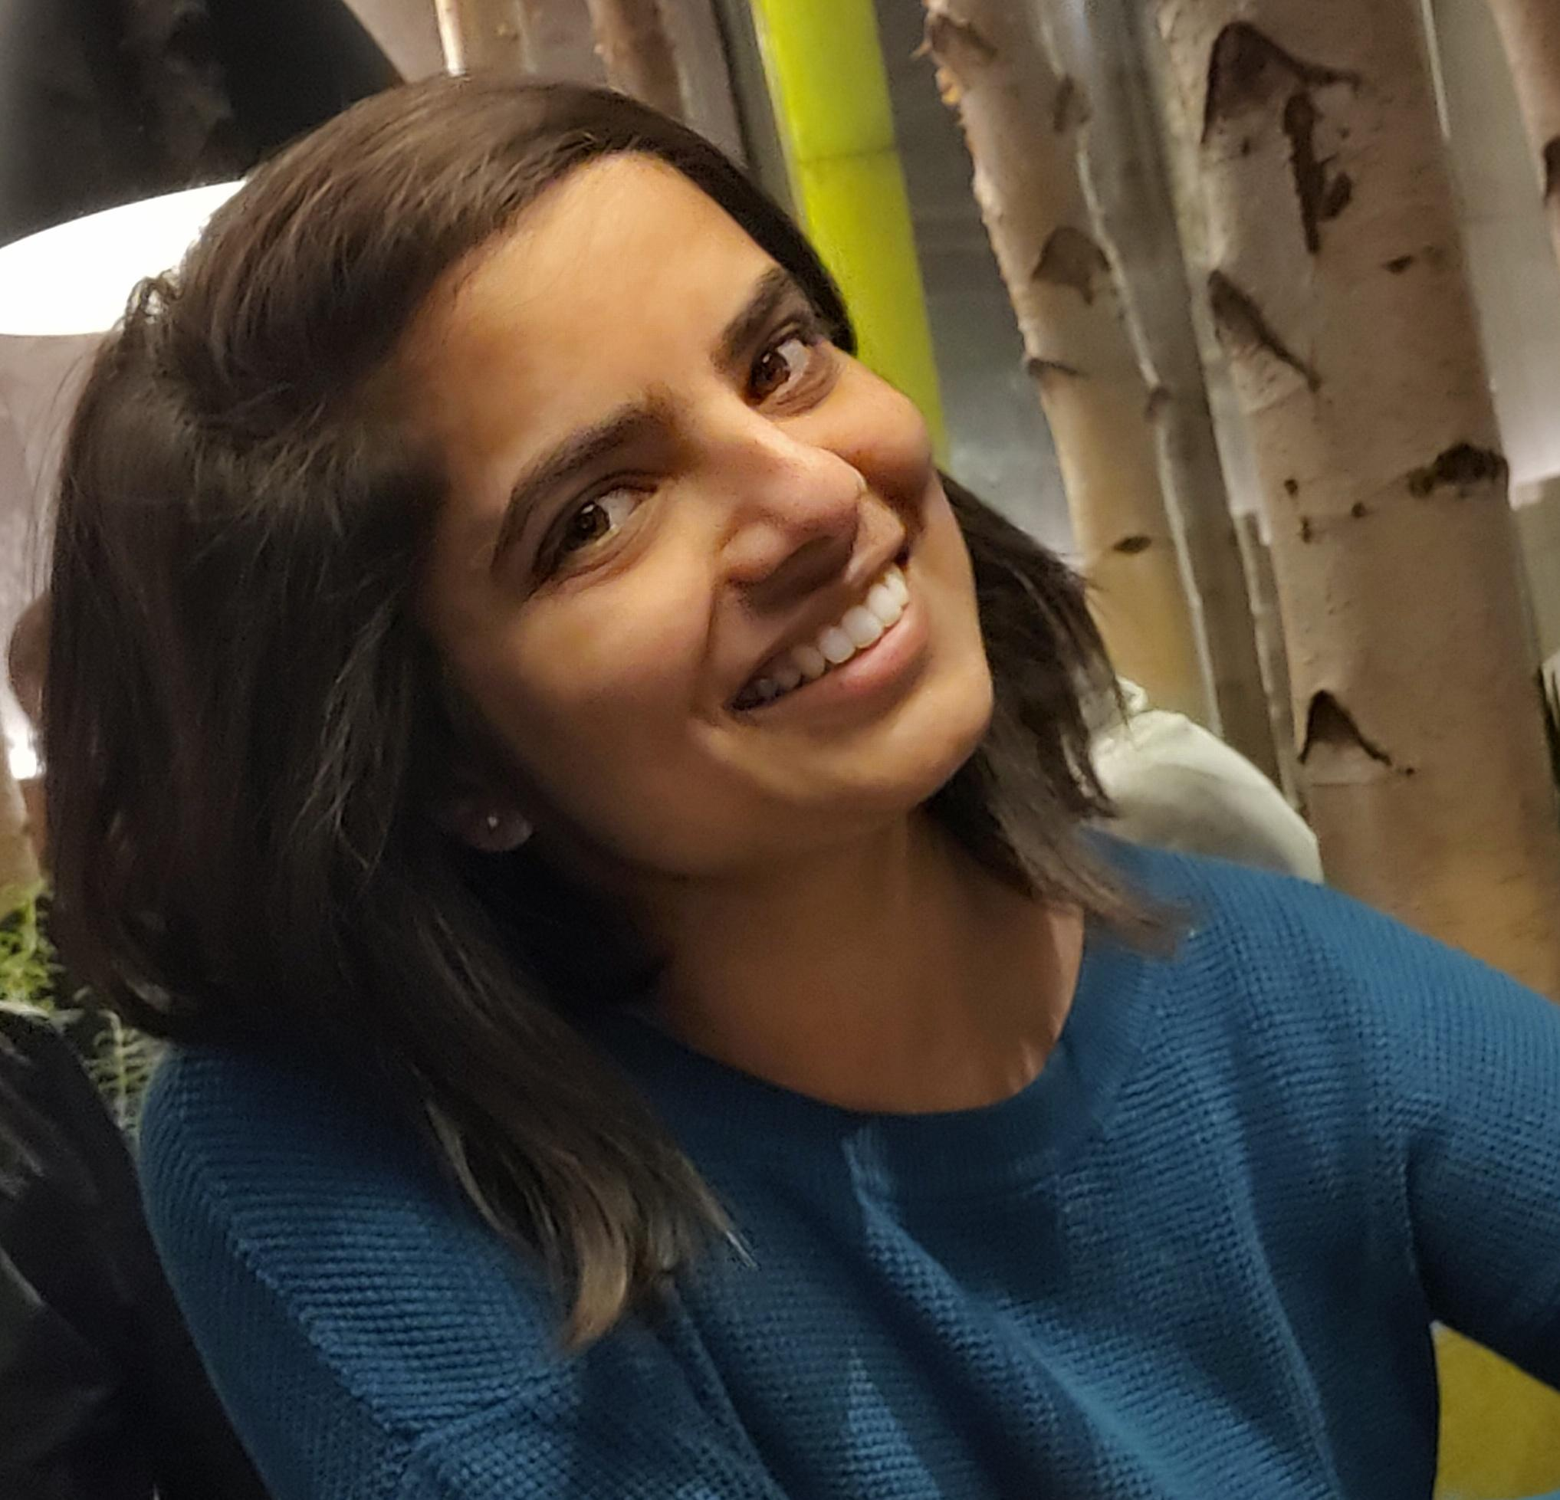
Our Team
Rachael Camp (Speaker) UX/ Visual Designer
Shruti Pistolwala (Speaker)
Rapid Prototyping and Innovation
Anran Cai Business Lead / Epidemiologist
Lucie Huang Tech Developer
Letícia Gonçalves Designer
Arati Shinde
Business Lead
Notes:
This is our interdisciplinary team consisting of people having expertise in various domains such as Tech, Business and UX design.

Slide 13

Check out our prototype by scanning the QR code!
Notes:
No scan the QR code and checkout our prototypes and we are ready to take your questions.

Slide 14
References
Source: Cullati, S., Courvoisier, D.S., Gayet-Ageron, A. et al. Patient enrollment and logistical problems top the list of difficulties in clinical research: a cross-sectional survey. BMC Med Res Methodol 16, 50 (2016). https://doi.org/10.1186/s12874-016-0151-1
Slide 3: Based on our observations and a report by CBI Insights

Slide 15
Revenues and costs
Phase 1
Merck endorsement
Compensation
Development
Phase 2
Commission from clinical trial organizers
Development & Roll-out, Server storage
Tie-up, Marketing
Phase 3
License purchase from clinical trial organizers, current existing clinical trial search and register platforms
Development & Roll-out
Server storage
Notes:
In case they ask for question

